Slide 1


Slide 2
Alkyl Halides, Alcohols, and Phenols

Slide 3
Amines, Nitriles and Ethers

Slide 4
Carbonyls

Slide 5
More Carbonyls

Slide 6
Identifying Functional Group Order

Slide 7
Identifying Multiple Functional Groups

Slide 8
Alkyl Halides, Alcohols and Phenols
Amines, Nitriles, and Ethers
Carbonyls
More Carbonyls
Identifying Functional Group Order
Identifying Multiple Functional Groups
$100
$100
$100
$100
$100
$100
$200
$200
$200
$200
$200
$200
$300
$300
$300
$300
$300
$300
$400
$400
$400
$400
$400
$400
$500
$500
$500
$500
$500
$500

Slide 9
What type of elements are alkyl halides composed of?

Slide 10
R-X
An R group and a halogen (X = F, Cl, Br, I)

Slide 11
What is the difference between and alcohol and a phenol?

Slide 12
A phenol contains an alcohol bonded to an aromatic group.

Slide 13
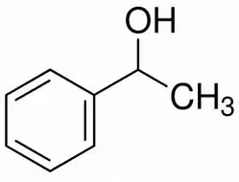
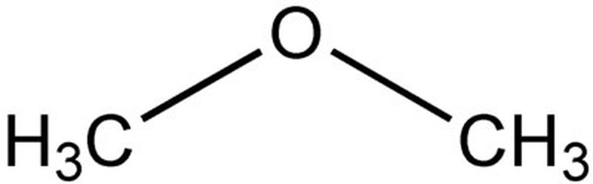
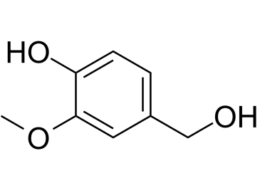
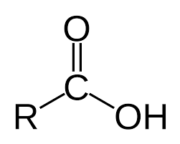
Which is an alcohol?

Slide 15
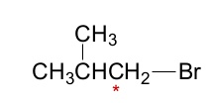
Is this a 1°, 2°, or 3° alkyl halide?

Slide 16
Primary

Slide 17
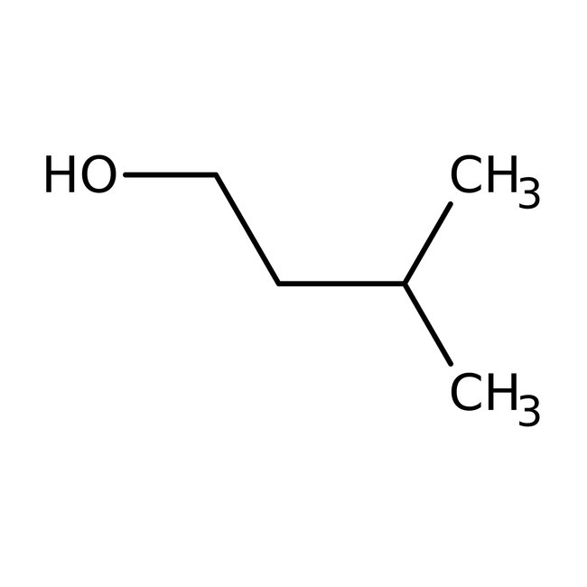
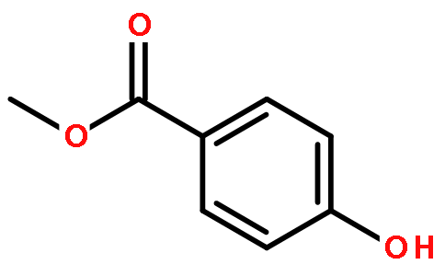
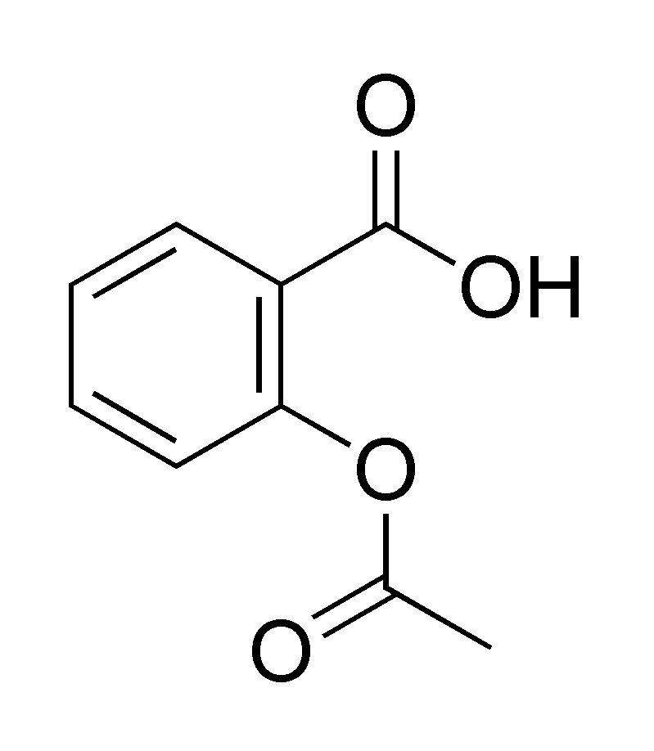
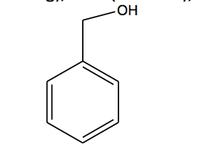
Which of the following is a phenol?

Slide 19
What elements make up an Amine?

Slide 20
R-NH2, R2-NH, or R3-N

Slide 21
What constitutes and Ether?

Slide 22
R-O-R, an oxygen bonded to two separate Carbons.

Slide 23
What is the key component of a Nitrile group?

Slide 24
The triple bond between a Carbon and a Nitrogen, R-C≡N.

Slide 25
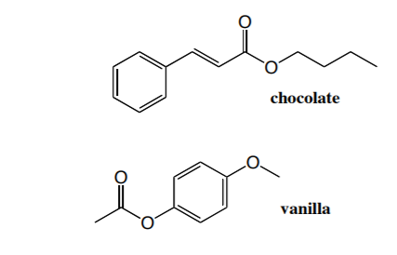
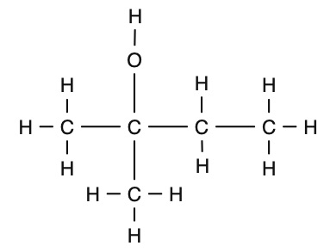
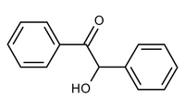
Which of the following has an ether?

Slide 26
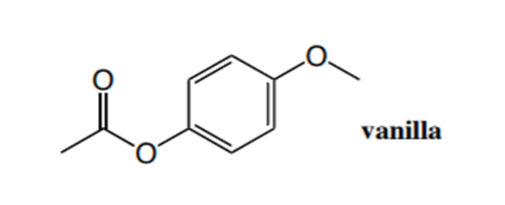

Slide 27
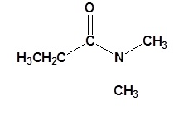
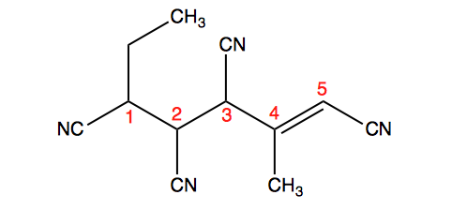
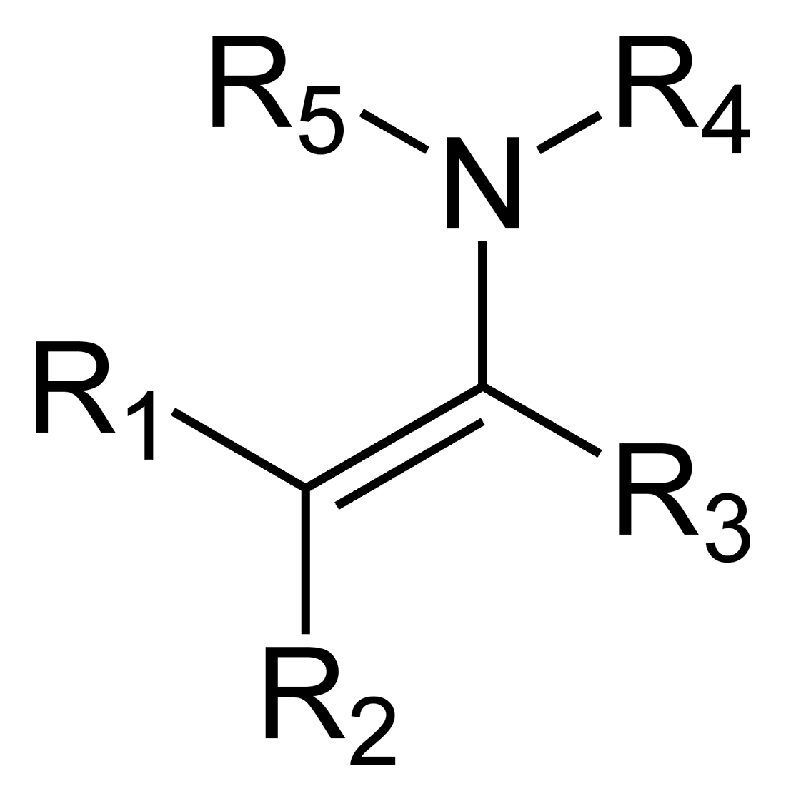
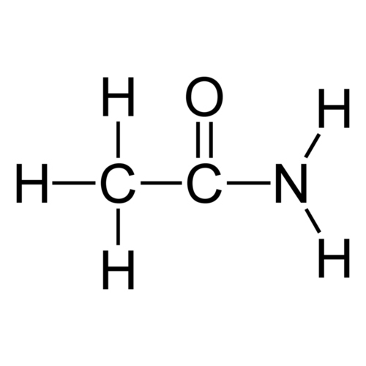
Which of the following is an amine?

Slide 28


Slide 29
What is a Carbonyl?

Slide 30
It is a C=O.

Slide 31
What is the difference between an ester and an ether?

Slide 32
An ester has a C=O and a C-O, while an ether only has a C-O.

Slide 33
What is the difference between an amide and an amine?

Slide 34
An amide has a carbonyl group attached to the same carbon as the C-N.

Slide 35
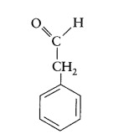
Identify the functional group in the following.

Slide 36
Aldehyde

Slide 37
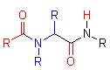
Name the following functional group.

Slide 38
There are 2 amide groups.

Slide 39
What is the difference between a carboxylic acid and a an alcohol?

Slide 40
A carboxyl acid has a hydroxyl group and a carbonyl bonded to the same Carbon.

Slide 41
What is the difference between an aldehyde and a ketone?

Slide 42
An aldehyde has a C=O at the end of an organic chain, whereas a ketone has a C=O that has to be bonded to at least two other carbons.

Slide 43
What is an acid chloride?

Slide 44
A carbonyl with an attached Cl.

Slide 45
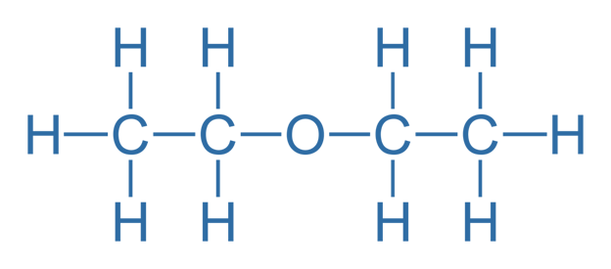
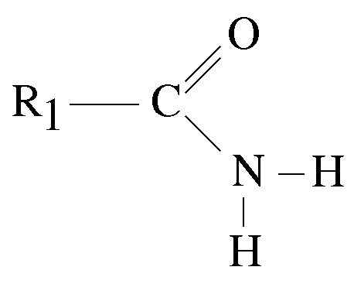
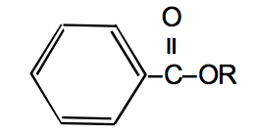
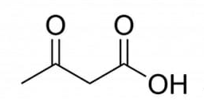
Identify the ester.

Slide 46
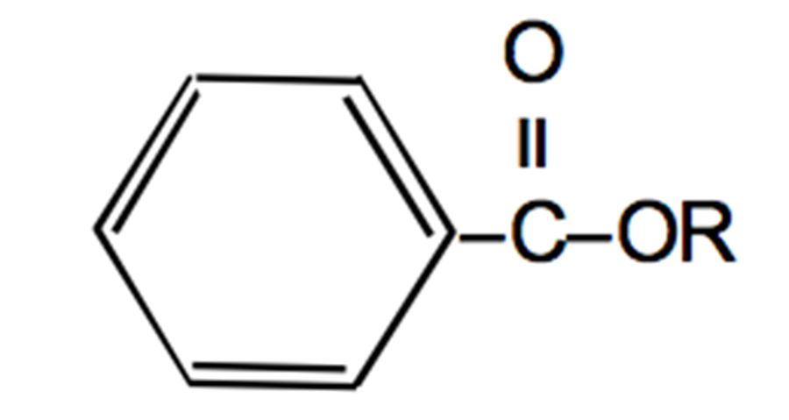

Slide 47
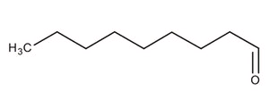
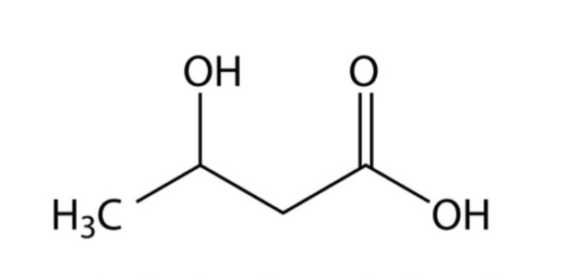
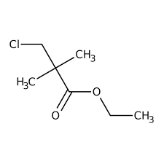
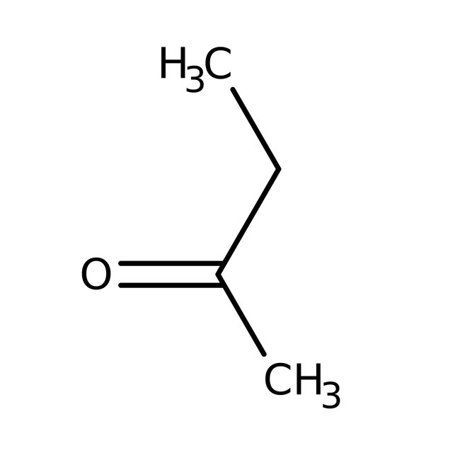
Which of the following is an aldehyde?

Slide 48
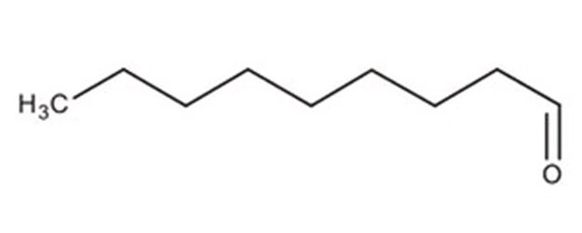

Slide 49
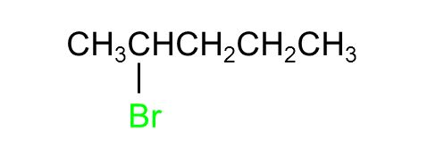
Identify the functional group and order (1°, 2°, or 3°).

Slide 50
Secondary Alkyl Halide

Slide 51
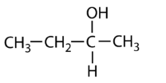
Identify the functional group and order (1°, 2°, or 3°).

Slide 52
Secondary Alcohol

Slide 53
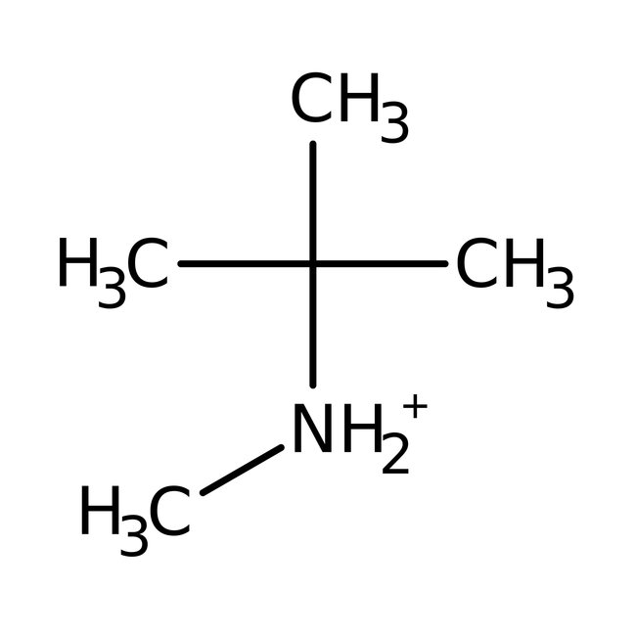
Identify the functional group and order (1°, 2°, or 3°).

Slide 54
Secondary Amine

Slide 55
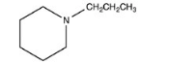
Identify the functional group and order (1°, 2°, or 3°).

Slide 56
Tertiary Amine

Slide 57
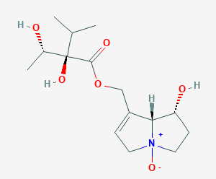
Identify the functional group and order (1°, 2°, or 3°).

Slide 58
There are 2 secondary alcohols, a tertiary alcohol and a secondary amine.

Slide 59
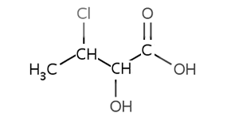
Identify the functional groups in the following.

Slide 60
There is an alcohol, a carboxylic acid, and an alkyl halide.

Slide 61
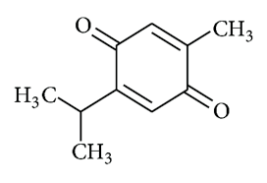
Identify the functional groups in the following.

Slide 62
There are 2 ketones.

Slide 63
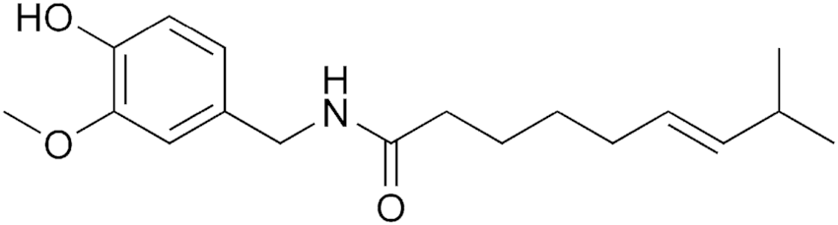
Identify the functional groups in the following.

Slide 64
There is a phenol, an ether, and an amide.
Bonus: alkene

Slide 65
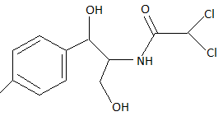
Identify the functional groups in the following.

Slide 66
There are 2 alcohols, an amide, and an alkyl halide.

Slide 67
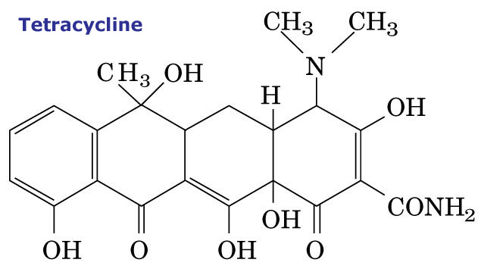
Identify the functional groups in the following.

Slide 68
There is a phenol, 2 ketones, 4 alcohols, an amine and an amide.

Slide 69


Slide 70
What type of functional group is involved in peptide bonds?

Slide 71
Amides

