Slide 1
TEST 2

Slide 2
Instructions for use
EDIT IN GOOGLE SLIDES
Click on the button under the presentation preview that says "Use as Google Slides Theme".
You will get a copy of this document on your Google Drive and will be able to edit, add or delete slides.
You have to be signed in to your Google account.
EDIT IN POWERPOINT®
Click on the button under the presentation preview that says "Download as PowerPoint template". You will get a .pptx file that you can edit in PowerPoint.
Remember to download and install the fonts used in this presentation (you’ll find the links to the font files needed in the Presentation design slide)
More info on how to use this template at slidescarnival.com/help-use-presentation-template
This template is free to use under Creative Commons Attribution license. You can keep the Credits slide or mention SlidesCarnival and other resources used in a slide footer.

Slide 3
Panel
Acids/Bases
Index of Hydrogen Deficiency
Some More ACID/Base
Chair Conformations
Newman Projections
NOmenclature
$200
$200
$200
$200
$200
$200
$400
$400
$400
$400
$400
$400
$600
$600
$600
$600
$600
$600
$800
$800
$800
$800
$800
$800
$1000
$1000
$1000
$1000
$1000
$1000

Slide 4
What is an Electrophile?
Acids/Bases· $200
Notes:
Lewis Acid, are positive, but electron loving want to take electrons.

Slide 5
What is the relation between Ka and Pka?
Acids/Bases· $400
Notes:
Inversley related

Slide 6
If you have an acid with a high pKa value what does it say about it?
AciDs/Bases· $600
Notes:
The acid is a weak acid, would have a low Ka value.

Slide 7
Is palmitoleic acid (has 16 carbons) soluble in water? If no, what is it possibly soluble in?
AcIDS/BAses· $800
Notes:
No carboxylic acids with more than 1 carbon are insoluble in water. Can be soluble in aq. NaOH.

Slide 8
What are the 7 strong acids?
ACIDS/bases· $1000
Notes:
HCl, HBr, HI, H2SO4, HNO3, HClO3, HClO4

Slide 9
What is the formula for calculating SATURATED acyclic alkanes?
IHD· $200
Notes:
CnH2n+2

Slide 10
When calculating IHD what do you do when oxygen is in the compound?
IHD· $400
Notes:
Ignore Oxygen and continue calculating the IHD.

Slide 11
What is the IHD of C6H5NO?
IHD· $600
Notes:
IHD = 5
Ignore O, take away 1 H for each N

Slide 12
How much less H’s are in a compound with 3 rings and 4 double bonds?
IHD· $800
Notes:
3*2=6 and 4*2 = 8 6+8 = 14 or 7IHD bc 7 pairs of H2

Slide 13
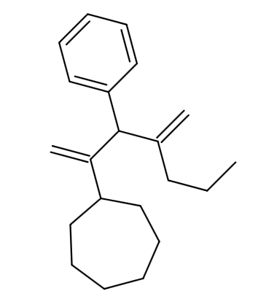
What is the IHD in this compound?
IHD· $1000
Notes:
IHD= 7 or 14 H’s deficient

Slide 14
What affect does s character have on acidity?
Some More ACID/Base · $200
Notes:
More s character means higher acidity

Slide 15
If the conjugate base of an acid is strong what does that mean of the acid?
Some More ACID/Base · $400
Notes:
The acid was a weak acid

Slide 16
How will a positive entropy contribute to Gibbs Free energy?
Some More ACID/Base · $600
Notes:
Will contribute negatively to Gibbs free energy and thus favor product formation at equilibrium.

Slide 17
Explain Inductive Effects
Some More ACID/Base · $800
Notes:
Electronic effects transmitted through bonds, comes from a group, the effect decreases as the distance from the group becomes larger.

Slide 18
How do you set up the equilibrium constant (Keq) calculation in this reaction?
HCl + NH3 → Cl + HNH3
ACIDS/bases · $1000
Notes:
Products/Reactant concentrations

Slide 19
What conformation is less stable than chair conformation?
Chairs· $200
Notes:
Boat conformation

Slide 20
Where is it more stable to place a tert-butyl group on a chair conformation?
Chairs· $400
Notes:
An equatorial position, not axial.

Slide 21
What occurs to an equitorial down bond in a chair flip? What about and axial up bond?
CHairs· $600
Notes:
Equatorial down bond becomes axial down. Axial up bond becomes equatorial up.

Slide 22
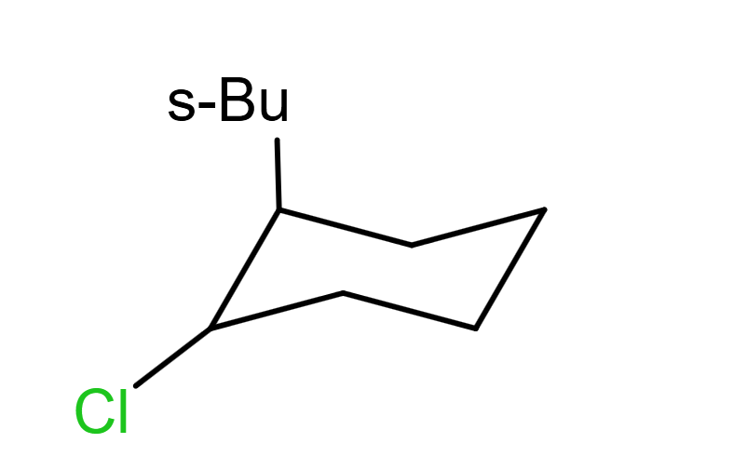
How can this cyclohexane chair conformation become more stable?
Chairs· $800
Notes:
Do a chair flip so the sec-butyl group will be in an equatorial up position and Chlorine will be in the axial down position.

Slide 23
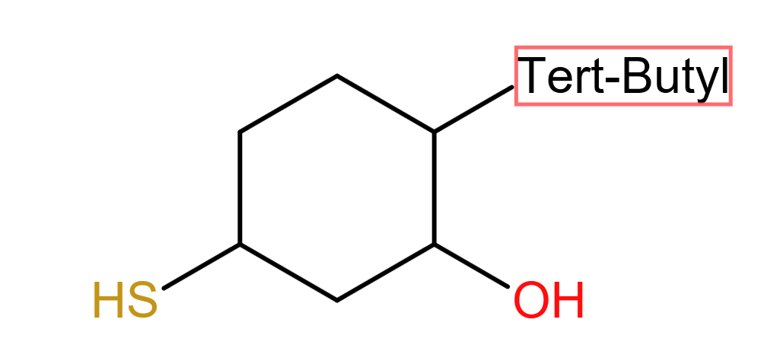
Convert the cyclohexane to the most stable chair conformation
CHAIRS· $1000

Slide 24
What is the angle degree between bonds in a gauche conformation?
NM Projections· $200
Notes:
60 degrees

Slide 25
What Newman Projection conformation has the highest potential energy?
NMP · $400
Notes:
Eclipsed

Slide 26
What cyclic structure has the greatest angle and torsional strain? Which has the least?
NMP · $600
Notes:
Cyclopropane has most, cyclohexane has least

Slide 27
Create the Newman projection for heptane with the front carbon being carbon 2 and the back carbon being carbon 3.
NMP · $800

Slide 28
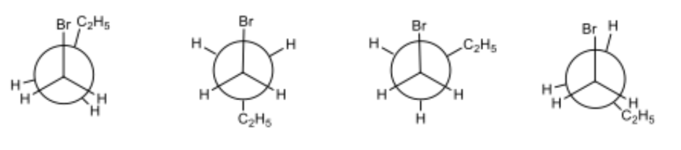
Rank the following Newman projections from 1-4 with 1 being the most stable.
NMP · $1000
Notes:
4,1,2,3

Slide 29
What is the parent name of a 5 carbon chain with one triple bond?
Nomenclature · $200
Notes:
pentyne

Slide 30
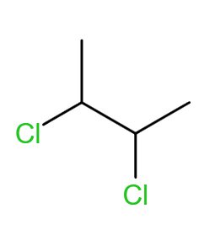
What is the name of the compound?
Nomenclature · $400
Notes:
Cis-2,3-dichlorobutane

Slide 31
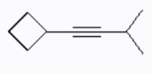
Name this compound:
Nomenclature · $600
Notes:
1-cyclobutyl-4-methyl-2-pentyne

Slide 32
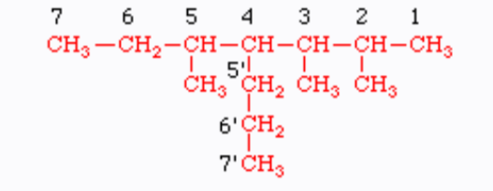
Name the following compound:
Nomenclature· $800
Notes:
2,3,5-trimethyl-4-propylheptane

Slide 33
Draw 6-chlorohept-4-en-2-yne
Nomenclature· $1000

Slide 34
Winner!

Slide 35
Credits
Special thanks to all the people who made and released these awesome resources for free:
Presentation template by SlidesCarnival

Slide 36
Presentation design
This presentation uses the following typographies:
Titles: Bebas Neue
Body copy: Della Respira
Download for free at:
https://www.fontsquirrel.com/fonts/bebas-neue
https://www.1001fonts.com/della-respira-font.html
You don’t need to keep this slide in your presentation. It’s only here to serve you as a design guide if you need to create new slides or download the fonts to edit the presentation in PowerPoint®

Slide 37
MAP

Slide 38
GADGETS

Slide 39
SlidesCarnival icons are editable shapes.
This means that you can:
Resize them without losing quality.
Change fill color and opacity.
Change line color, width and style.
Isn’t that nice? :)
Examples:
Find more icons at slidescarnival.com/extra-free-resources-icons-and-maps

Slide 40
Diagrams and infographics

Slide 41
😉
You can also use any emoji as an icon!
And of course it resizes without losing quality.
How? Follow Google instructions https://twitter.com/googledocs/status/730087240156643328
✋👆👉👍👤👦👧👨👩👪💃🏃💑❤😂😉😋😒😭👶😸🐟🍒🍔💣📌📖🔨🎃🎈🎨🏈🏰🌏🔌🔑 and many more...

Slide 42

Free templates for all your presentation needs
For PowerPoint and Google Slides
100% free for personal or commercial use
Ready to use, professional and customizable
Blow your audience away with attractive visuals

